Slide 1
CARDIOVASCULAR DISEASE
DISEASE THAT AFFECTS THE HEART OR BLOOD VESSELS

Slide 2
TYPES OF CVD
Hypertension--high blood pressure
Risk factor for other types of CVD
Called the “silent killer”
More common over age 35
One-third of adults have it
Manage weight, get adequate physical activity, and eat a nutritious diet

Slide 3
TYPES CONT.
ATHEROSCLEROSIS
BUILD UP OF PLAQUE ON ARTERY WALLS
CAUSES ARTERIOSCLEROSIS-HARDENED ARTERIES
MAIN CAUSE IS UNHEALTHY FOOD CHOICES—EATING FATTY FOODS

Slide 4
DISEASES OF THE HEART
ANGINA PECTORIS—chest pain from the heart not getting enough oxygen, usually caused by atherosclerosis
ARRHYTHMIAS—irregular heartbeats, ventricular fibrillation is most common cause of cardiac arrest
HEART ATTACK—occurs when a reduced or blocked blood supply damages the heart muscle
CONGESTIVE HEART FAILURE—occurs when the heart weakens and can no longer maintain its regular pumping rate and force, cannot be cured

Slide 5
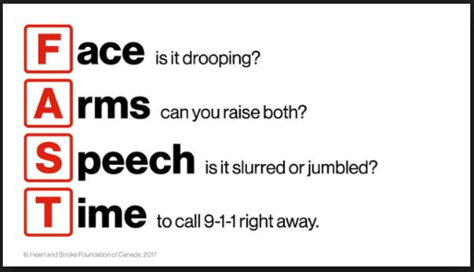
ONE LAST TYPE…
STROKE—acute injury in which blood flow to the brain is interrupted
Warning Signs: severe headache, numbness to one side of the body, confusion, trouble walking, dizziness, and trouble seeing out of one or both eyes

Slide 6
CONTROLLABLE RISK FACTORS
TOBACCO USE
HIGH BLOOD PRESSURE
HIGH CHOLESTEROL
PHYSICAL INACTIVITY
EXCESS WEIGHT
STRESS
ALCOHOL AND DRUG USE

Slide 7
RISK FACTORS OUT OF OUR CONTROL
HEREDITY
GENDER—MEN HAVE GREATER RISK
AGE—INCREASES AS YOU GET OLDER, 80 % OF PEOPLE WHO DIE FROM CVD ARE 65 OR OLDER

Slide 8
WHAT YOU NEED TO KNOW
HEART DISEASE IS THE LEADING CAUSE OF DEATH FOR ADULTS IN THE U.S.
CVD CAN START TO DEVELOP DURING ADOLESCENCE
KNOWING RISK FACTORS CAN HELP YOU MAKE A COMMITMENT TO REDUCE YOUR RISK

